Slide 1
Potential of Islamic Leasing (Ijarah)Products:
- By Abdella Adem
            Islamic Banking Director,
            Awash Bank, Ethiopia.

Slide 2
Introduction
Financial sector plays a very vital role in the economic progress on any country and it is considered as the backbone of the economy.
Hence, stronger economic system is dependent on healthy banking system of the country.
There are two main modes of banking systems, Islamic banking and the alternative conventional banking. Both modes of banking differ from each other in many ways and offer different financial products for the consumer. BUT, Both needs collaterals as security for any financial loans (Financing extended).
In both forms of lease (Ijarah and conventional) bank acts as Lessor (lease giver) and the party to whom the service, benefit or asset is given is called Lessee (lease taker).
The lessor asks the lessee to pay periodic rentals for reaping or enjoying lease benefits and the ownership remains with the lessor, solely the rights of use is transferred to lessee.

Slide 3
Ijarah (Leasing)
Ijarah is a contract of exchange between an asset owner who offers the usufruct of the asset in exchange for a mutually agreed consideration. The asset owner remains the owner of the asset, but leases the asset to the lessee who would enjoy the economic benefits or usufruct of the asset in exchange for a rental or lease amount.
It has to be noted that the classical application of the contract of Ijarah is only an exchange of the usufruct for a rental payment with very clear distribution of rights and liabilities. However, modern-day application of Ijarah contracts may have clauses that create serious friction with the purity of Ijarah contracts.
The bank purchases and leases out assets required by their clients for a rental fee with the option to either purchase such assets during the period of rent or at the end of the contract.
It provides the guarantee of regular payments all through the life of the financing with the flexibility of structuring the payment plan in a manner that makes it possible for Islamic Banks to accomplish a profit margin similar to that of conventional ones.
This is the most efficient and flexible way to facilitate high cost assets and technology related products.
Ownership of the asset remains with the lessor bank, which will seek to recover the capital cost of the asset plus a profit margin from the lease or rents payable.
Ijarah method is widely used for long-term projects, which have two distinctive phases (i) the construction phase and (ii) the operations phase.

Slide 4
BASIC RULES OF IJARA
Transferring of usufruct not ownership
- To another person for an agreed price, at an agreed consideration/period.
Subject of lease: Valuable, Identified and Quantified
Consumable things cannot be leased out
- Anything which cannot be used without consuming cannot be leased out; e.g., money, wheat etc.
All Liabilities of ownership are borne by lessor Corpus of leased property remains in the ownership of the seller.

Slide 5
Period of lease
- Must be determined in clear terms at the time of contract
Lease for specific purpose only:
The property may be used only for the specified object of the contract
If no specific purpose is identified, then it can be used for any purpose for which it is used in normal course;
Any sub-lease of the asset requires the permission of the lessor in the contract.
Rents can be fixed or variable. Any reference to a rate of reference date or formula should be specifically stated in the contract.
▪Lessee as Ameen
- The lessee is liable to compensate the lessor for every harm to the leased asset caused by any misuse or negligence. The leased asset shall remain in the risk of the lessor throughout the lease period.
Lease of jointly owned property
- Is permitted and rentals shall be distributed between all the joint owners according to the proportion of their respective shares in the property.

Slide 6
Determination of Rental
The rental must be determined at the time of contract for the whole period of lease.
It is permissible that different amounts of rent are fixed for different phases during the lease period, If the amount of rent for each phase is specifically agreed upon at the time of effecting a lease.
The determination of rental on the basis of the aggregate cost incurred in the purchase of the asset by the lessor, as normally done in financial leases, is not against the rules of Shariah.
The lessor cannot increase the rent unilaterally, and any agreement to this effect is void. The lease period shall commence from the date on which the leased asset has been delivered to the lessee.
Rental will be charged when the Leased asset is handed over to the lessee. Any advance before delivery must be adjusted with future rents.
Leasing should not be interest-based loan or replacing interest with rent, rather it should comply with all of the above conditions.

Slide 7
Benefits of IJARAH or Lease Financing
Leasing is a relatively recent technique for financing investment. It can be categorized as a form of long- and medium-term credit.
Compliance with Shari a principles makes it a privileged formula used by Islamic Banks to finance investment in their relationships.
The advantage of Ijarah financing is to the strength of the guarantee provided to the Bank as a legal owner of the asset.
For the economic operators, the advantages of leasing are multiple.
  It allows them to renovate their outdated or obsolete equipment and thus benefit from the latest technological developments.
  Advantage of avoiding long-term or medium-term fixed assets of part of their resources in the case of a self-financed acquisition or even financed by an investment loan.
Indeed, the annual expenses, within the framework of a financing are limited to the rents due during the period, which is very appreciated by the Banks, which have difficulty balancing their financial situation.
Firms that opt ​​for this type of financing can benefit from the positive difference between the amount of annual rents and the amount of depreciation that they should have recorded on their own funds if the property had been subject to an acquisition.
Finally, the margin of maneuver left to be used,

Slide 8
Conditions to be Applied in Business for Lease Financing (IJARAH)
The object of the lease (the use of the leased property) must be known and accepted by both parties.
The lease must be for durable goods, i.e. non-destructible as a result of enjoyment or use.
The leased property as well as the accessories necessary for its use must be given to the user in a state to be used for the use for which the property is intended.
The duration of the lease, the period of payment, the amount of the rent and the periodicity must be determined and known at the conclusion of the leasing contract.
The rent may be paid in advance, in advance or in installments according to the agreement of the parties.
The two parties may agree upon a revision of the rent, the duration of the lease and any other terms of the contract.
The destruction or degradation of the leased asset of an act beyond the control of the user shall be the responsibility of the user only if it is established and the necessary measures have not been taken to conserve the leased object, Well with the care of a good father of family.
Unless otherwise agreed, it shall be the Bank’s responsibility to perform any major maintenance and repair work required to maintain the leased asset in a state of use for its intended use.
  Likewise, it bears all rental charges prior to the lease. The user maintains the use of the leased property, as well as all the rental expenses incurred from the date of rental.
The leased asset may be subleased, unless otherwise agreed.
  Similarly, the Bank may lease property acquired from its own seller, provided that the sale is real and not fictitious (Lease back).

Slide 9
The case of Ethiopia, Awash Bank
We have started Islamic Banking since the end of 2013.
Now more than 10 out of 16 conventional Banks are offering Islamic banking deposit products through the WINDOW MODEL & So far, about 41 Billion Birr, equivalent to USD 1.4 Billion Dollar, is mobilized.
But only 5 started financing, less than 5% only is disbursed. They are liquid.
Additionally, about 5 full-fledged Islamic Banks are under formations.
Awash Bank will be the first to start IJARAH IN ETHIOPIA. a

Slide 10
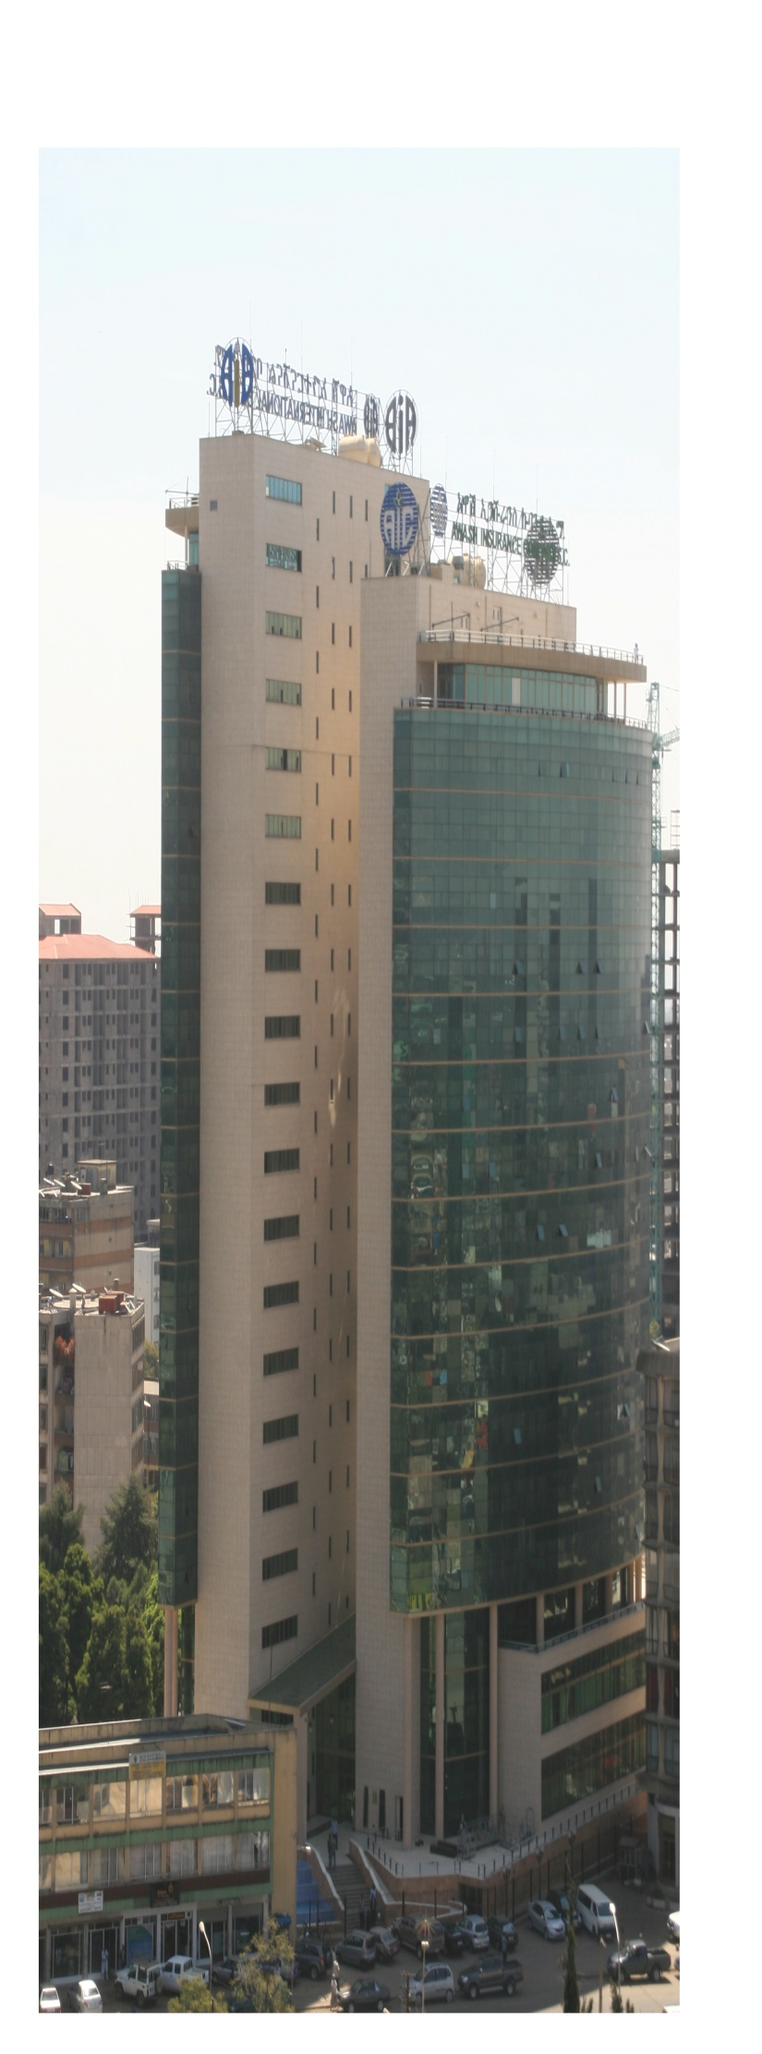


1. Promise to lease
3. Bank leases the asset to the client
4.Promise to sell or gift on maturity
5.Periodic Rentals
6. Transfer of ownership
Prospect Lessee/Customer
AWASH BANK
2.Bank buys the asset
Asset Vendor

Slide 11
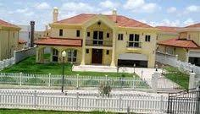
1. Promise to lease
3. Bank leases the asset to the client
4.Promise to sell or gift on maturity
5.Periodic Rentals
6. Transfer of ownership
Prospect Lessee/Customer
AWASH BANK
2.Bank buys the asset
Asset Vendor/Developer

Slide 12
Conclusions
Ethiopia is with more than 110 Million, about 45% populations are Muslims and more than 50% are youths, poors who can not present any collaterals.
Banks are usually extending the loan (financing) facility by demanding additional collaterals, which is causing huge challenges in ensuring accessibility by the poor.
Though there is huge demands for working capitals, many Islamic Banks are usually not giving any cash money to their customers;
Ijarah has indispensable role and potential in solving both challenges and ensure equitable distribution of Wealth, the main purpose of Every Islamic banks.
Banks can manage risks by Takaful & assigning residual values to Assets, they can earn any market opportunity throughouts!
Ijarah can operates within legal frameworks, designed for conventional Banks
So, there is huge potential in the Ethiopian market both for Banks and Customers to choose and start IJARAH
Awash Bank is currently starting to offer IMB!

Slide 13


